Slide 1
MOVIE TICKET BOOKING SYSTEM

Slide 2
OBJECT ORIENTED PROGRAMMING PROJECT
THEORY TEACHER : MISS SADIA MOOQADDAS
LAB INSTRUCTOR : MISS NAFEESA IQBAL

Slide 3
ROAD MAP
Introduction
Uses of this Project
Structure
Class’s Hierarchy
Functionality
Conclusion
FAQ’s

Slide 4
INTRODUCTION
Movie Ticket Booking System provides users a computerized platform to book movie tickets
This System will have information related to Movies
User will be directed to provide personal information for ticket Booking

Slide 5
USES OF THIS PROJECT
This project can be used as E-Ticketing
By following the basis of this project, we can make more projects based on systematic working
Can be launched as an application to provide ease and convenience to users
Reduces time consumption as compare to physical ticket booking

Slide 6
STRUCTURE
Project consists of 4 classes i.e, Ticket, Booking, MovieBooking and Booking System. Inheritance being used is “Multi-level Inheritance”
Classes are being used in this project to store and get the data member’s information
Class Ticket is stand alone class, Booking is a Parent class of Class Movie Booking whereas BookingSystem is the child class of class MovieBooking
We have used the concepts of Abstraction, Encapsulation, Multi-level Inheritance, Polymorphism, Exception, File Handling and vector

Slide 7
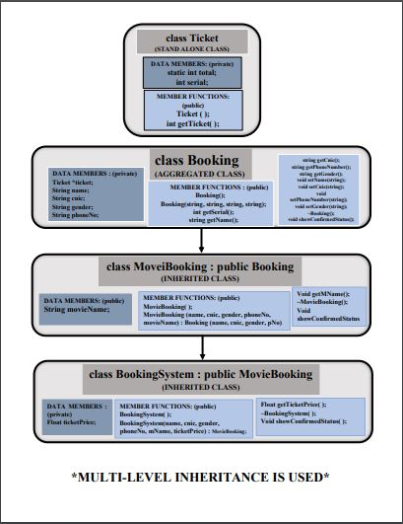
Class hierarchy

Slide 8
FUNCTIONALITY
User will be taken to Main Menu
Here User can Book Ticket, View Ticket, Delete Ticket, View Movie List, Search Ticket and Exit the interface
We have used vector to save all the information related to Movie Booking
Concept of File Handling saves and provides the booking information as long as the info is present in the text file
Constructors are being used to set the class’s data member’s values
Functioning has been done in the Driver’s Code

Slide 9
DRIVER’S CODE
Header Files (iostream, cstring, vector, fstream and bookingsys.h)
Functions used in main ( ) function are mainMenu( ), bookTicket ( ), viewTicket ( ), deleteTicket ( ), searchBooking ( ), chooseMovie ( ), movieList ( ), TicketPrice ( ) and BookingSystem *setTicket ( )
File Handling has been done in int main ( )

Slide 10
Why VECTOR?
Arrays, as compare to vector and list, takes the space in the memory at the time of declaration
In big projects, we need herds of information to be saved but we also want that if we delete some information, our memory space should get cleared but in the case of array, the memory space remains the same
Vector provide us this advantage of taking only that amount of space which we want. If we delete some element of vector, the space in the memory gets empty
This makes our program to work efficiently

Slide 11
conclusion
Having advantages and disadvantages, our project covers some great concepts of OOP. By implementing these concepts at this very level, we are now very much aware of what OOP brings to us as a programmer
This project has covered all the basis of OOP and can be modified and updated in the near future for adding up advanced features in it
The pathway of this project has opened a vast programming world for us and has made us much curious get more deep into the world of OOP.

Slide 12
Project prepared by
SYED ASAD ABBAS
SANIA ISHAQ
KIRAN KHALID

Slide 13
FAQ’s

Slide 14
THANK YOU

